Slide 1

Data Security and Cryptology
Moshe Peretz, Tal Yehoshua, Tal-Chen Ben-Eliyahu

Slide 2
Salsa20 in OFB
Elgamal
RSA
An Application for secure email exchange
+
encryption-decryption
secret key delivery
+
Digital signature

Slide 3
About Us: Group 9
Moshe Peretz: 318263977
Tal Yehoshua: 314774860
Tal-Chen Ben-Eliyahu: 318173044

Slide 4
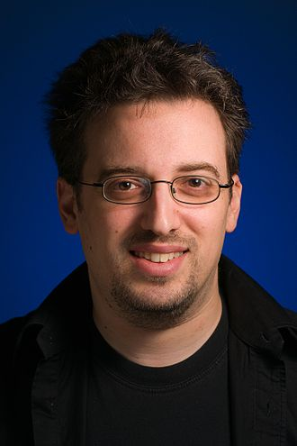
Salsa 20 introduction
Salsa20 is a modern and efficient stream symmetric cipher.
Salsa20 has been submitted to the eSTREAM European Union cryptographic validation.
It was designed in 2005 by Daniel Bernstein.

Slide 5
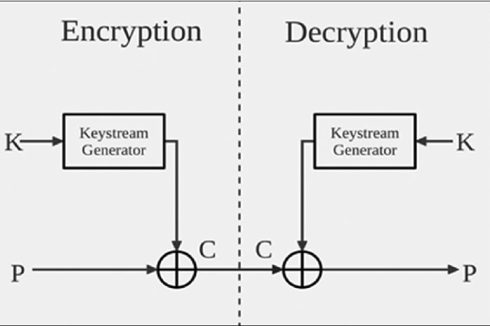
Stream Cipher
A symmetric key cipher where the plaintext digits are combined with pseudorandom cipher digit stream.
In a stream cipher, each plaintext digit is encrypted one at a time with the corresponding digit of the keystream, to give a digit of the ciphertext stream.

Slide 6
Motivation for Using Salsa20
It is considered to be a well-designed and efficient algorithm. To this day there aren’t effective attacks on the family of Salsa20 ciphers.
The salsa20 structure provides the ability in recreating every specific block from the encrypted text within a constant time and can reach up to 643 mb/s in efficiencies.
In 2013 a study has been published that Salsa20/15 is safe against Brute-Force.
Notes:
Back at 2007 an attack has been developed on Salsa20 with 8 rounds with time of decryption of 2^255 with 2^11.37 keys. At 2012 the attack of Amson and Shai against Salsa20/8 as succeeded to break the encryption in 2^109 or in 2^250 in case with key of 32 bytes.

Slide 7
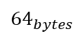
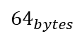
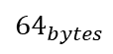
Salsa20- Overview
Key {16 \ 32 bytes}
nonce {8 bytes}
Block number {8 bytes}
Expansion function
$${64}_{bytes}$$
Hash function
$${64}_{bytes}$$
DoubleRound function
10 X
$${64}_{bytes}$$
Block data
ciphertext

Slide 8
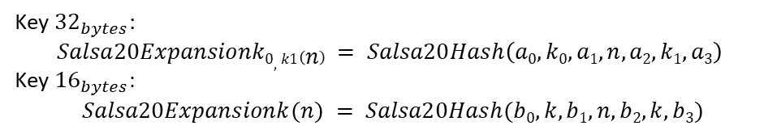
Salsa20 – How it works?
Salsa20Expantion
Key ${32}_{bytes}\text{:}$ $$Salsa20Expansionk0, k1\left(n\right) = Salsa20Hash\left(a0, k0, a1, n, a2, k1, a3\right)$$ Key ${16}_{bytes}:$ $$Salsa20Expansionk(n) = Salsa20Hash(b0, k, b1, n, b2, k, b3)$$

Slide 9
Salsa20 – How it works?
Salsa20Expantion
$$Salsa20Hash \left(x_{0},..,x_{15}\right) =\left(x_{0},..,x_{15}\right)+DoubleRound^{10}(x_{0},..,x_{15})$$
Salsa20Hash

Slide 10
Salsa20 – How it works?
Salsa20Expantion
Salsa20Hash
DoubleRound X10
$$DoubleRound (x_{0},..,x_{15}) =RowRound (ColumnRound(x_{0},..,x_{15}))$$

Slide 11
Salsa20 – How it works?
Salsa20Expantion
Salsa20Hash
DoubleRound X10
ColumnRound call the QuarterRound 4 times with constants
RowRound
RowRound call the QuarterRound 4 times with constants
ColumnRound
QuarterRound
$${64}_{bytes}$$

Slide 12
nonce
nonce is an IV - initial vector, that was created from a random (or pseudo-random) numbers
For example: nonce = [E1, 02, 71, 42, E4, 09, F8, 05]

Slide 13
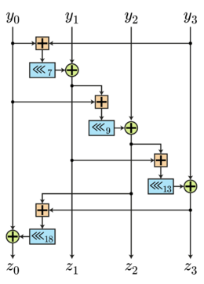
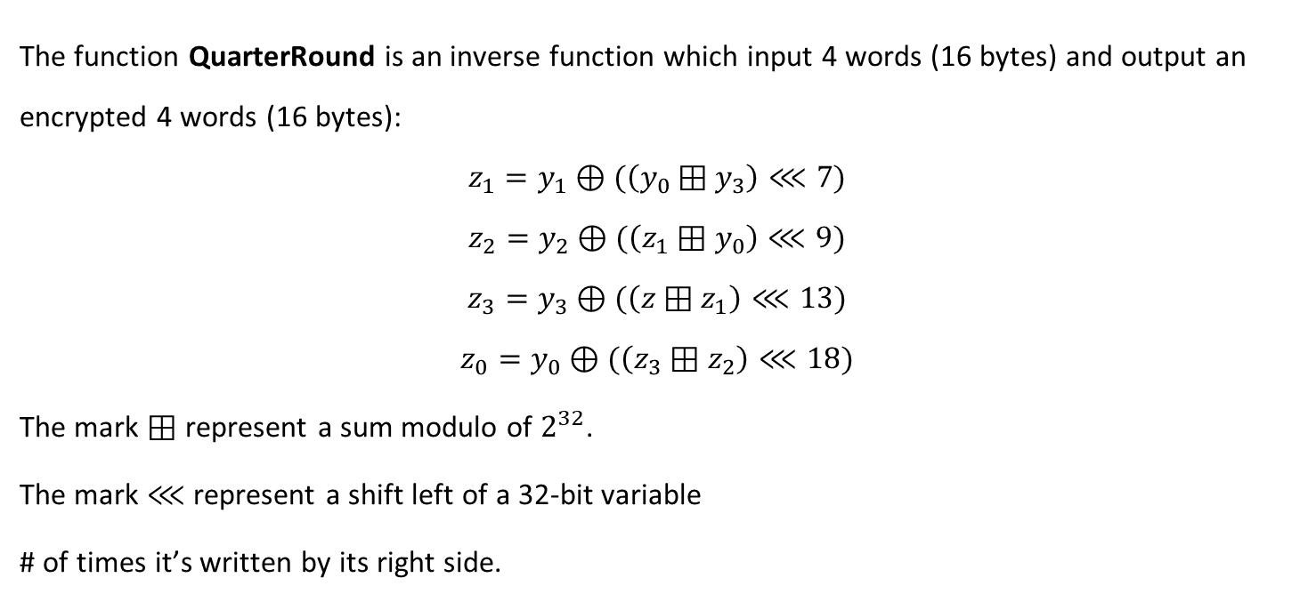
QuarterRound
The function QuarterRound is an inverse function which input 4 words (16 bytes) and output an encrypted 4 words (16 bytes): $$z_{1}=y_{1}⊕(\left(y_{0}⊞y_{3}\right)⋘7)$$
$$z_{2}=y_{2}⊕(\left(z_{1}⊞y_{0}\right)⋘9)$$
$$z_{3}=y_{3}⊕(\left(z⊞z_{1}\right)⋘13)$$
$$z_{0}=y_{0}⊕(\left(z_{3}⊞z_{2}\right)⋘18)$$
The mark $⊞$ represent a sum modulo of $2^{32}$.
The mark $⋘$ represent a shift left of a 32-bit variable
# of times it’s written by its right side.
Notes:
$$z_{1}=y_{1}⊕(\left((y_{0}+y_{3})mod2^{32}\right)⋘7)$$

Slide 14
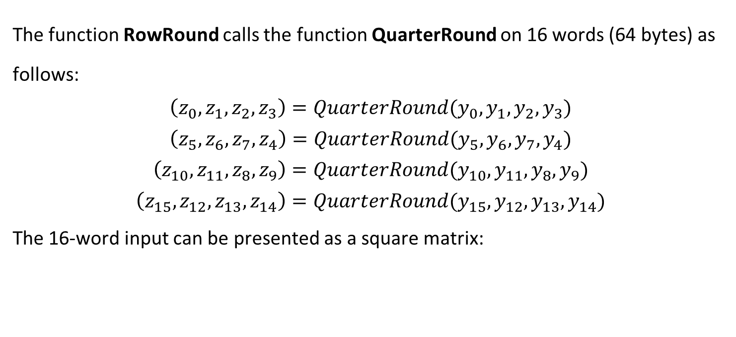
RowRound
The function RowRound calls the function QuarterRound on 16 words (64 bytes) as follows:
$$\left(z_{0},z_{1},z_{2},z_{3}\right)=QuarterRound(y_{0},y_{1},y_{2},y_{3})$$
$$\left(z_{5},z_{6},z_{7},z_{4}\right)=QuarterRound(y_{5},y_{6},y_{7},y_{4})$$
$$\left(z_{10},z_{11},z_{8},z_{9}\right)=QuarterRound(y_{10},y_{11},y_{8},y_{9})$$
$$\left(z_{15},z_{12},z_{13},z_{14}\right)=QuarterRound(y_{15},y_{12},y_{13},y_{14})$$
The 16-word input can be presented as a square matrix:
y0 | y1 | y2 | y3
y4 | y5 | y6 | y7
y8 | y9 | y10 | y11
y12 | y13 | y14 | y15

Slide 15
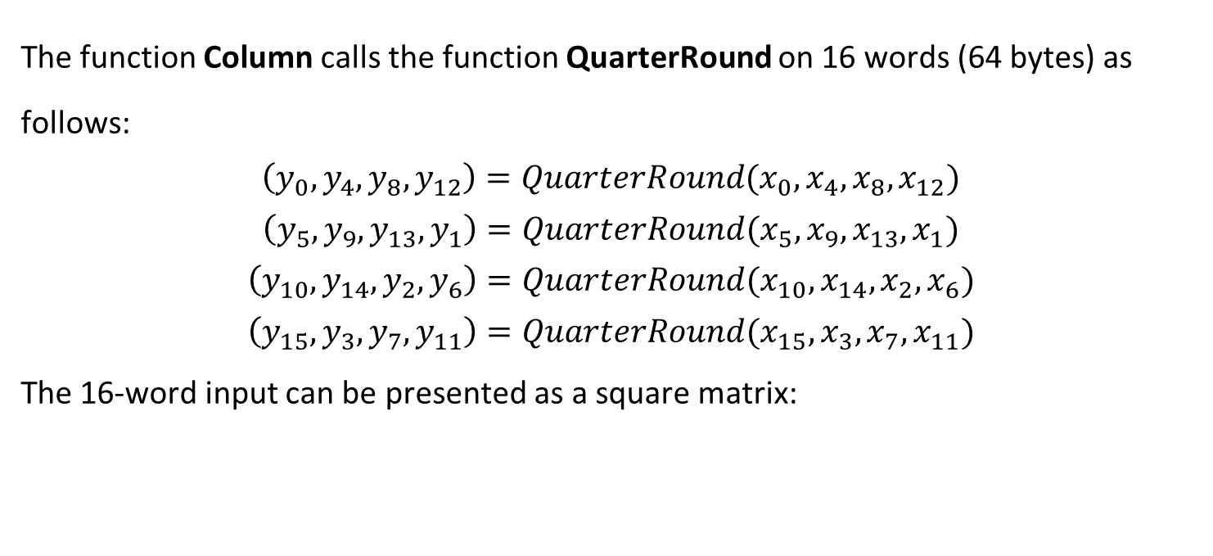
ColumnRound
The function Column calls the function QuarterRound on 16 words (64 bytes) as follows:
$$\left(y_{0},y_{4},y_{8},y_{12}\right)=QuarterRound(x_{0},x_{4},x_{8},x_{12})$$
$$\left(y_{5},y_{9},y_{13},y_{1}\right)=QuarterRound(x_{5},x_{9},x_{13},x_{1})$$
$$\left(y_{10},y_{14},y_{2},y_{6}\right)=QuarterRound(x_{10},x_{14},x_{2},x_{6})$$
$$\left(y_{15},y_{3},y_{7},y_{11}\right)=QuarterRound(x_{15},x_{3},x_{7},x_{11})$$
The 16-word input can be presented as a square matrix:
x0 | x1 | x2 | x3
x4 | x5 | x6 | x7
x8 | x9 | x10 | x11
x12 | x13 | x14 | x15
Notes:
Does actually the same as RowRound but call QuarterRound on the matrix cols instead of the rows

Slide 16
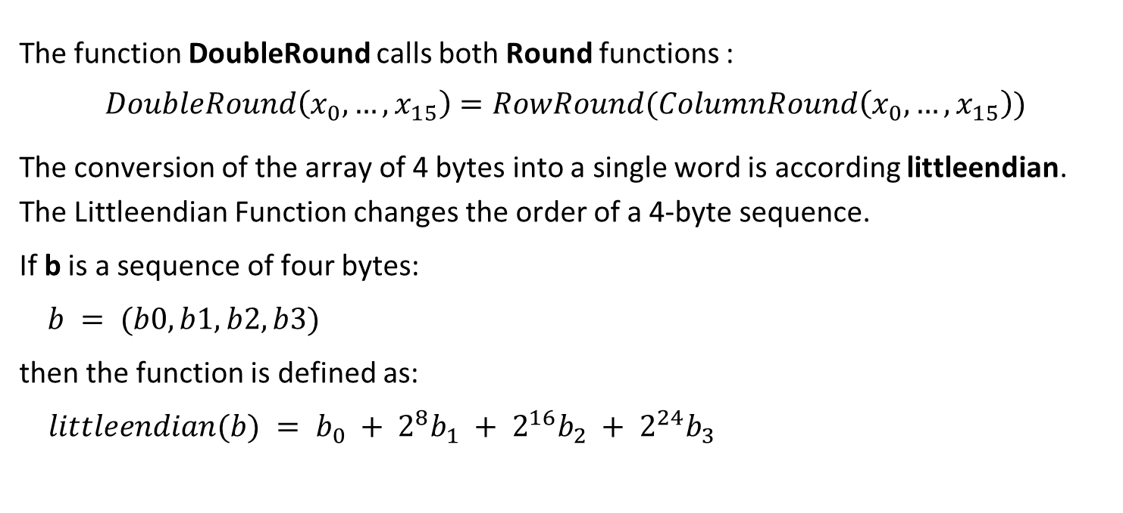
DoubleRound
The function DoubleRound calls both Round functions :
$$DoubleRound\left(x_{0},…,x_{15}\right)=RowRound(ColumnRound\left(x_{0},…,x_{15}\right))$$
The conversion of the array of 4 bytes into a single word is according littleendian.
The Littleendian Function changes the order of a 4-byte sequence.
If b is a sequence of four bytes:
$b = (b0, b1, b2, b3)$
then the function is defined as:
$littleendian(b) = b_{0} + 2^{8}b_{1} + 2^{16}b_{2} + 2^{24}b_{3}$
Notes:
Does actually the same as RowRound but call QuarterRound on the matrix cols instead of the rows.
לצורך הפעולות האריתמטיות, המעבר ממערך של ארבעה בתים למילה אחת הוא לפי סדר בתים קטן שאומר שהבית הראשון מייצג את הספרות הפחות משמעותיות של המילה, לכן במחשב עם סדר בתים גדול, יש צורך בפונקציית המרה כדי להמיר מבתים למילים ובחזרה לפי הנוסחה: b0 + 2^8b1 + 2^16b2 + 2^24b3

Slide 17
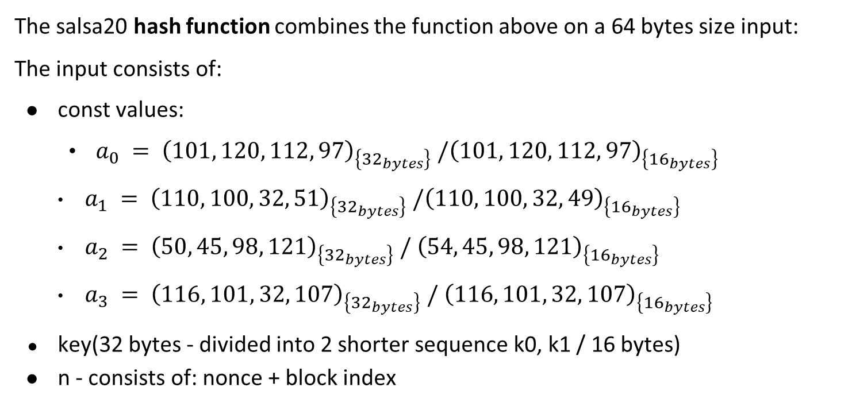
Hash Function
The salsa20 hash function combines the function above on a 64 bytes size input:
The input consists of:
const values:
$a_{0} = {\left(101, 120, 112, 97\right)}_{\left\{{32}_{bytes}\right\}}{ /\left(101, 120, 112, 97\right)}_{\left\{{16}_{bytes}\right\}}$
$a_{1} = {\left(110, 100, 32, 51\right)}_{\left\{{32}_{bytes}\right\}} /{\left(110, 100, 32, 49\right)}_{\left\{{16}_{bytes}\right\}}$
$a_{2} = {\left(50, 45, 98, 121\right)}_{\left\{{32}_{bytes}\right\}} / {\left(54, 45, 98, 121\right)}_{\left\{{16}_{bytes}\right\}}$
$a_{3} = {\left(116, 101, 32, 107\right)}_{\left\{{32}_{bytes}\right\}} / {\left(116, 101, 32, 107\right)}_{\left\{{16}_{bytes}\right\}}$
key(32 bytes - divided into 2 shorter sequence k0, k1 / 16 bytes)
n - consists of: nonce + block index

Slide 18
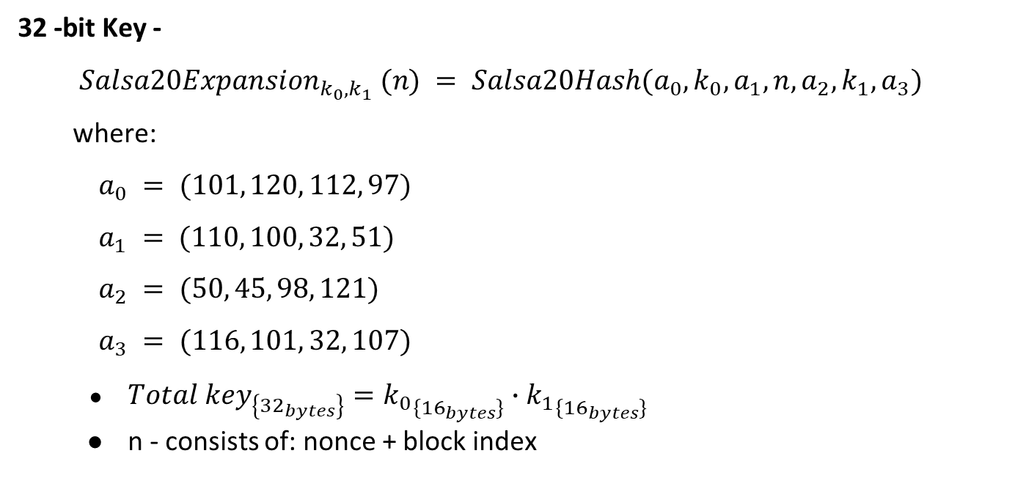
Hash Function
32 -bit Key -
$Salsa20Expansion_{k_{0}, k_{1}} (n) = Salsa20Hash(a_{0}, k_{0}, a_{1}, n, a_{2}, k_{1}, a_{3})$
where:
$a_{0} = (101, 120, 112, 97)$
$a_{1} = (110, 100, 32, 51)$
$a_{2} = (50, 45, 98, 121)$
$a_{3} = (116, 101, 32, 107)$
$Total key_{\left\{{32}_{bytes}\right\}}={k_{0}}_{\{{16}_{bytes}\}}∙{k_{1}}_{\{{16}_{bytes}\}}$
n - consists of: nonce + block index

Slide 19
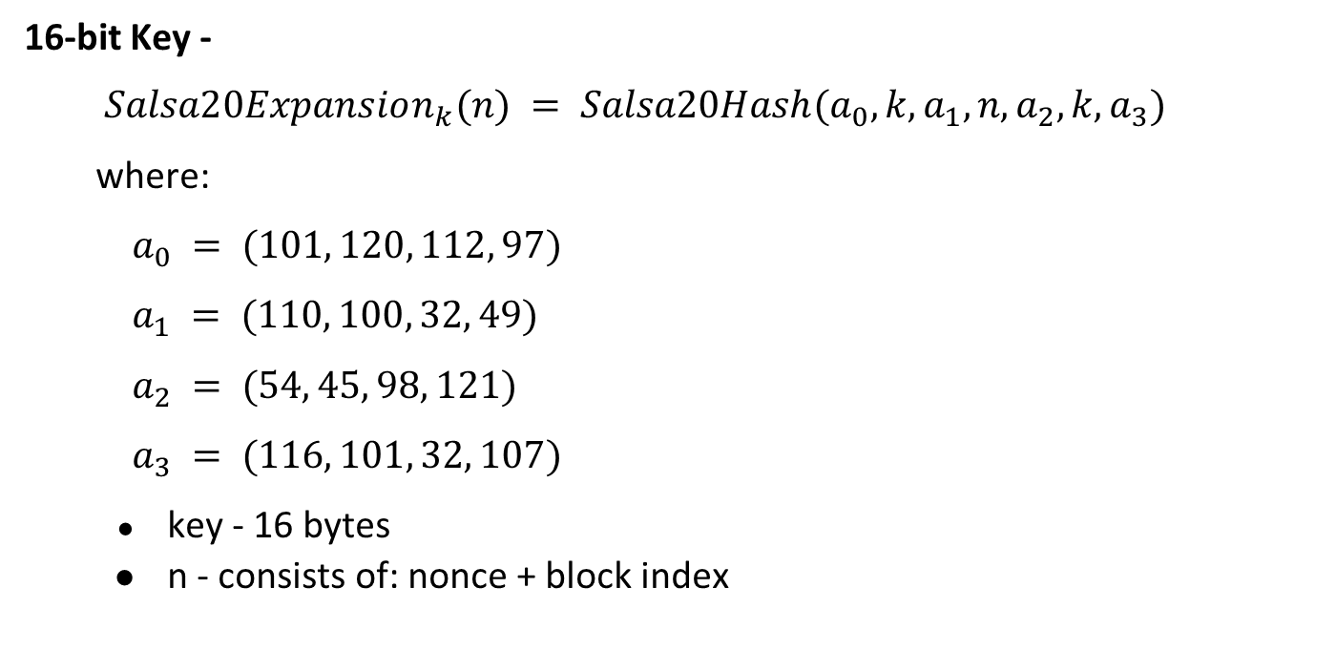
Hash Function
16-bit Key -
$Salsa20Expansion_{k}(n) = Salsa20Hash(a_{0}, k, a_{1}, n, a_{2}, k, a_{3})$
where:
$a_{0} = (101, 120, 112, 97)$
$a_{1} = (110, 100, 32, 49)$
$a_{2} = (54, 45, 98, 121)$
$a_{3} = (116, 101, 32, 107)$
key - 16 bytes
n - consists of: nonce + block index

Slide 20
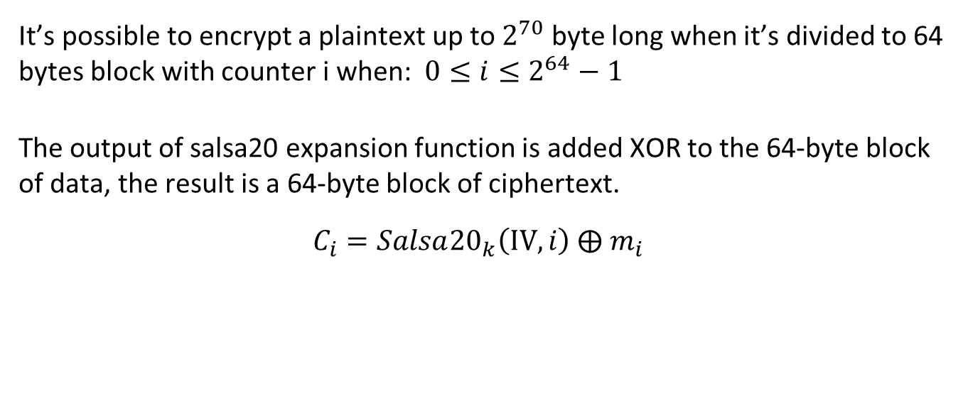
Salsa20 Encryption
It’s possible to encrypt a plaintext up to $2^{70}$ byte long when it’s divided to 64 bytes block with counter i when: $0≤i≤2^{64}−1$
The output of salsa20 expansion function is added XOR to the 64-byte block of data, the result is a 64-byte block of ciphertext.
$$C_{i}=Salsa{20}_{k}\left(IV,i\right) ⨁{ m}_{i}$$
Notes:
ניתן להצפין את המידע בגודל של $2^70$ מהסיבה שi יכול להיות לכל היותר 8 בתים כי : $2^{64}−1=8bytes$.
כעת, מכיוון שגודל כל בלוק הינו 64 בתים לכן כמות הבלוקים שנכנסת ב$2^{70}$ הינה:$\frac{2^{70}}{64}=\frac{2^{70}}{2^{6}}=2^{64}$.

Slide 21

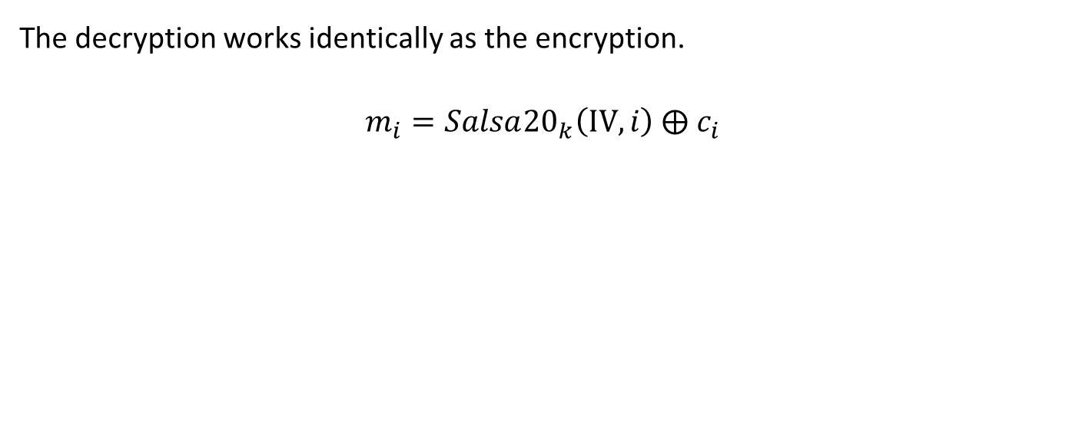
decryption salsa20
The decryption works identically as the encryption.
$m_{i}=Salsa{20}_{k}\left(IV,i\right) ⨁{ c}_{i}$

Slide 22
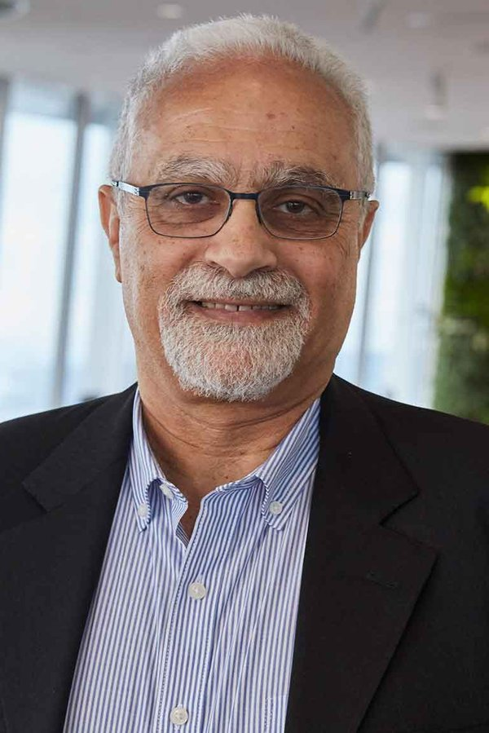
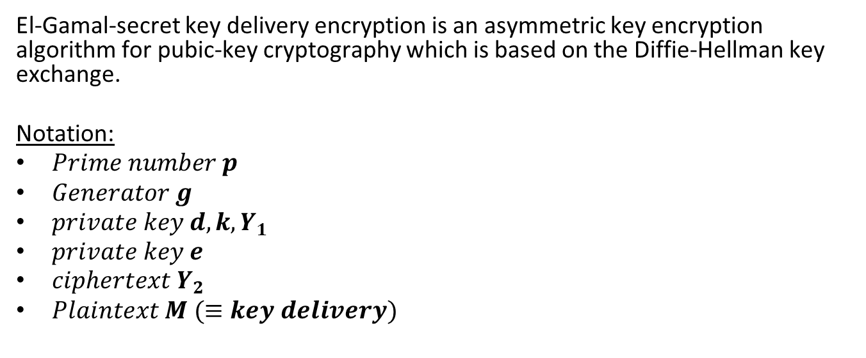
Elgamal introduction
El-Gamal-secret key delivery encryption is an asymmetric key encryption algorithm for pubic-key cryptography which is based on the Diffie-Hellman key exchange.
Notation:
$Prime number p$
$Generator g$
$private key d,k,Y_{1}$
$private key e$
$ciphertext Y_{2}$
$Plaintext M (≡key delivery)$
Described by Taher Elgamal in 1985
Notes:
g

Slide 23



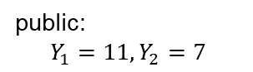
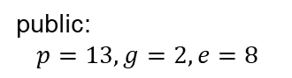
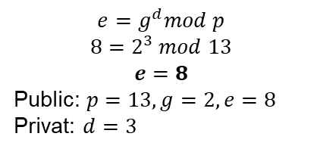
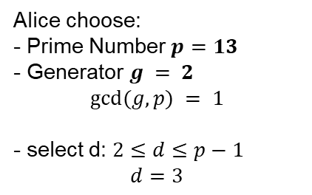
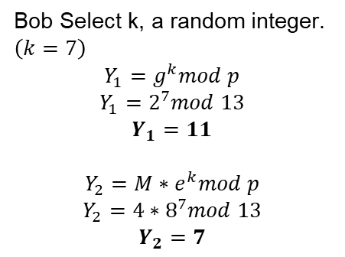
Elgamal encryption
Bob wants to send Message M = 4 to Alice (M should be less then p)
Alice choose:
- Prime Number $p=13$
- Generator $g = 2$
$$gcd⁡(g, p) = 1$$
- select d: $2≤d≤p−1$
$$d=3$$
Bob Select k, a random integer. $\left(k=7\right)$
$$Y_{1}=g^{k}mod p$$
$$Y_{1}=2^{7}mod 13$$
$$Y_{1}=11$$
$$Y_{2}={M∗e}^{k}mod p$$
$$Y_{2}={4∗8}^{7}mod 13$$
$$Y_{2}=7$$
Oscar
$$e=g^{d}mod p$$
$$8=2^{3} mod 13$$
$$e=8$$
Public: $p=13, g=2, e=8$
Privat: $d=3$
public:
$$p=13, g=2, e=8$$
Send to Bob
Send to Alice
public:
$$Y_{1}=11, Y_{2}=7$$
Bob the builder
Alice in wonderland

Slide 24
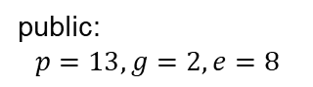
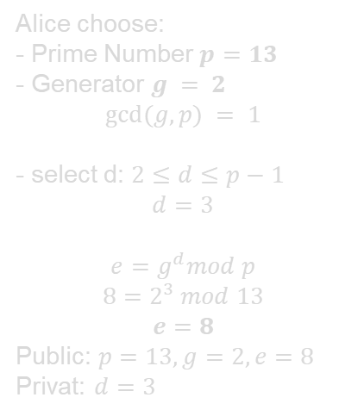
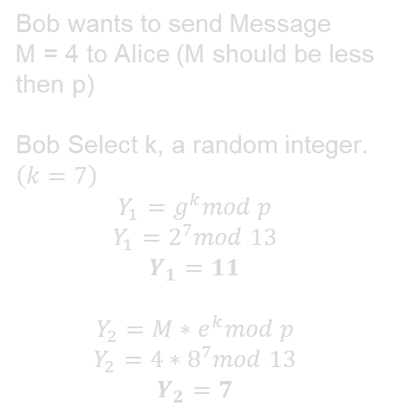
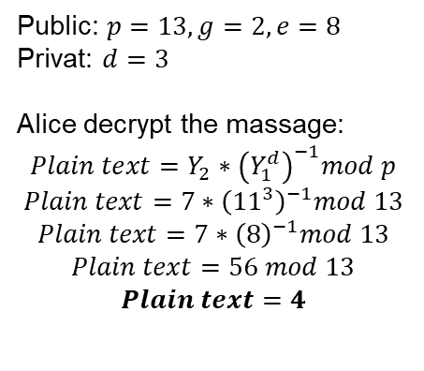
Elgamal encryption
Bob wants to send Message M = 4 to Alice (M should be less then p)
Bob Select k, a random integer. $\left(k=7\right)$
$$Y_{1}=g^{k}mod p$$
$$Y_{1}=2^{7}mod 13$$
$$Y_{1}=11$$
$$Y_{2}={M∗e}^{k}mod p$$
$$Y_{2}={4∗8}^{7}mod 13$$
$$Y_{2}=7$$
Alice choose:
- Prime Number $p=13$
- Generator $g = 2$
$$gcd⁡(g, p) = 1$$
- select d: $2≤d≤p−1$
$$d=3$$
$$e=g^{d}mod p$$
$$8=2^{3} mod 13$$
$$e=8$$
Public: $p=13, g=2, e=8$
Privat: $d=3$
Public: $p=13, g=2, e=8$
Privat: $d=3$
Alice decrypt the massage:
$$Plain text=Y_{2}∗{\left(Y_{1}^{d}\right)}^{−1}mod p$$
$$Plain text=7∗{\left({11}^{3}\right)}^{−1}mod 13$$
$$Plain text=7∗{\left(8\right)}^{−1}mod 13$$
$$Plain text=56 mod 13$$
$$Plain text=4$$
Oscar
Send to Bob
public:
$$p=13, g=2, e=8$$
Send to Alice
public:
$$Y_{1}=11, Y_{2}=7$$
Bob the builder
Alice in wonderland

Slide 25
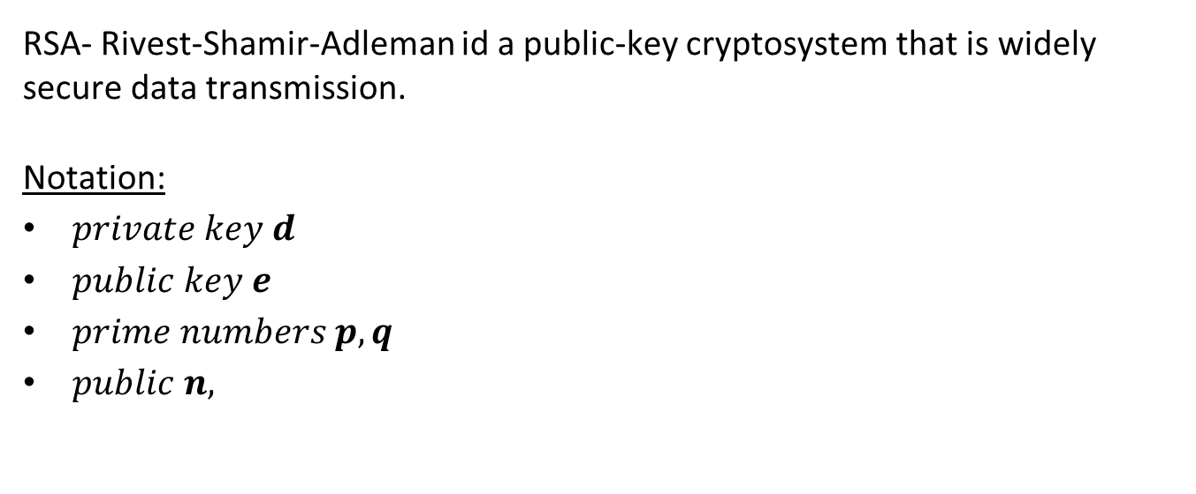
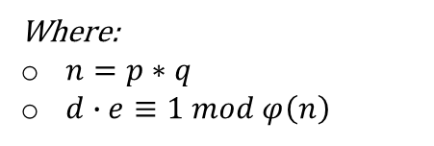
RSA introduction
RSA- Rivest-Shamir-Adleman id a public-key cryptosystem that is widely secure data transmission.
Notation:
$private key d$
$public key e$
$prime numbers p,q$
$public n,$
Where:
$n=p∗q$
$d∙e≡1 mod φ\left(n\right)$

Slide 26
RSA
How can Alice ensure that Bob send her the message?
Bob the builder
Alice in wonderland

Slide 27
RSA
Using RSA Signature, Alice can Verify that the message she received came from Bob
Bob the builder
Alice in wonderland

Slide 28
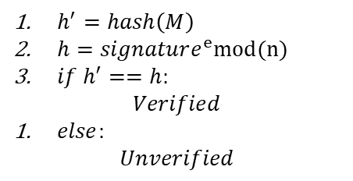
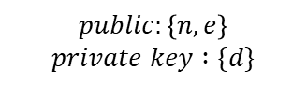
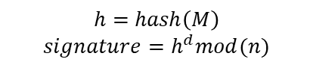
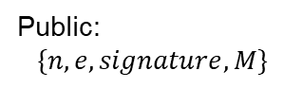
RSA Signature
Bob wants to send Message M to Alice
Bob choose
$$public:\left\{n, e\right\}$$
$$private key :\{d\}$$
Alice check
$h^{′}=hash\left(M\right)$
$h=signature^{e}mod(n)$
$if h^{′}==h:$
$$Verified$$
$else:$
$$Unverified$$
Bob executing
$$h=hash\left(M\right)$$
$$signature=h^{d}mod(n)$$
Send to Alice
Public:
$$\{n,e,signature, M\}$$
Bob the builder
Alice in wonderland
Notes:
Authentication-אימות שאכן בוב הוא השולח
data integrity- בזכות פונקציית ההאש אנו יכולים להיות בטוחים שההודעה אכן הגיעה בשלמותה
non-repudiation- בגלל שאליס השתמשה במפתח הציבורי של בוב לכן מכיוון שהחתימה נוצרה ע"י המפתח הפרטי של בוב אזי בוב לא יכול להגיד שלא הוא זה ששלח את ההודעה.

Slide 29





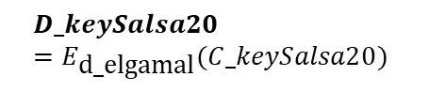

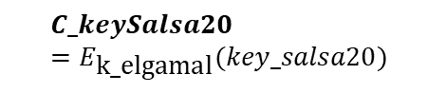
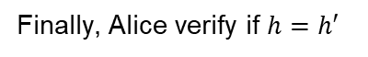
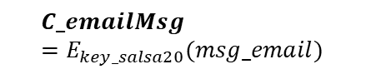
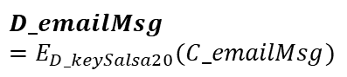
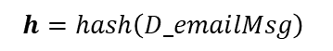
Email exchange
msg_email
prime_num_elgamal
Generator_elgamal
d_elgamal
k_elgamal
$$C_keySalsa20=E_{\text{k}\text{_}\text{elgamal}}(key_salsa20)$$
Send $C_keySalsa20$
$$D_keySalsa20=E_{\text{d}\text{_}\text{elgamal}}(C_keySalsa20)$$
key_salsa20
$$D_emailMsg=E_{D_keySalsa20}(C_emailMsg)$$
Send $C_emailMsg$
$$C_emailMsg=E_{key_salsa20}(msg_email)$$
$$h=hash\left(D_emailMsg\right)$$
public_key_RSA
private_key_RSA
n
Send $DS$
$$h^{′}=D_{publicRSA}(DS)$$
$$h=hash\left(msg_email\right)$$
$$DS=E_{private_key_RSA}(h)$$
Finally, Alice verify if $h=h′$
Bob the builder
Alice in wonderland

Slide 30


Slide 31


